Slide 1
The History of Louisiana Trust Law from 1882 to 2018 … and Beyond
Ronald J. Scalise Jr.
A.D. Freeman Professor of Civil Law
Tulane Law School

Slide 2
Early Days of Louisiana Law and the Resistance to the Trust: Pre 1882
Two Chief Hurdles to Recognition of the Trust
  The Civil Law’s resistance to bifurcated ownership
    Common Law – Division of Law (Enfeoff) and Equity (Uses)
    Civil Law – Ownership is unitary and conveys full dominion
  Louisiana’s prohibition on “substitutions and fidei commissa”
    All substitutions were prohibited
    Unclear what was meant by “fidei commissa”
      Succession of McCan (1895)

Slide 3
Early Days of Louisiana Law
and the Resistance to the Trust: Pre 1882
La. Civ. Code art. 1549 (1870)
“Donations made for the benefit of a hospital, of the poor of a community, or of establishments of public utility, shall be accepted by the administrators of such communities or establishments.”

Slide 4
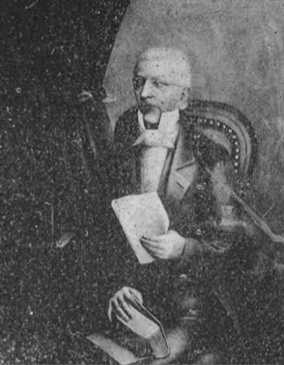
State v. McDonogh’s Executors,
8 La. Ann. 171 (1853)
John McDonogh

Slide 5
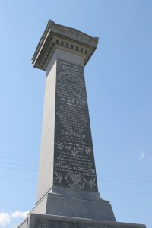
Milne’s Heirs v. Milne’s Executors,
17 La. 46 (1841)
Alexander Milne Monument in St. Louis Cemetery II

Slide 6
1882 – 1920
La. Act 124 of 1882
“…it shall be lawful for anyone to make a donation inter vivos or mortis causa of any description of property and to any amount to trustees, for educational, charitable or literary institutions, whether already existing at the time of the donation, or thereafter to be founded.”

Slide 7
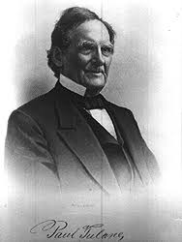
1882 – 1920
Paul Tulane

Slide 8
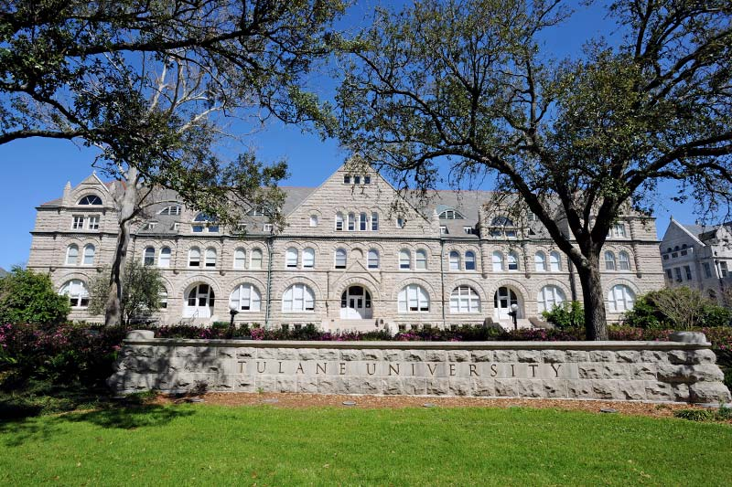
1882 – 1920
Tulane University

Slide 9
1882 – 1920
Section 8 of La. Act 124 of 1882
“…the provisions contained in the Revised Civil Code, or other laws of the this State, relative to substitutions, fidei commissa or trust depositions, shall not be deemed to apply to or in any manner affect donations made for the purposes and in the manner provided by this act….”

Slide 10
1882 – 1920
Succession of Kernan, 52 La. Ann. 48 (1899)
Facts: Donation to Archbishop of New Orleans to set up an “asylum or home for the poor of both sexes … similar, so far as possible, to that of St. Michael’s, in the city of Rome, Italy.
Rationale: “In our view, there is no escape from the conclusion that, because of the destination of the property and its revenues forever to the maintenance of the charitable institution, we have the trust estate, and the title only for the purposes of that trust, vested in the legatees.”
Holding: Unenforceable disposition

Slide 11
1882 – 1920
Succession of McCloskey (1900)
Donation “in trust to pay and apply any surplus … for such charitable purposes as they in their discretion shall think fit.”
La. Civ. Code art. 1573 (1870)
Prohibits the “willing by testament, by the intervention of a commissary or attorney in fact.” See also La. Civ. Code art. 1571 (2018).
La. Act 72 of 1918
It shall be “…lawful for anyone to make a donation … to a trustee … for educational, charitable or literary purposes generally, without designating the particular purpose to be fostered or aided, and in such cases to permit the trustee … to appoint, create, or change, from time to time and as often as they may deem wise, the beneficiary of such trust estate or any part thereof.”

Slide 12
1920 – 1938
La. Act 107 of 1920: First Authorization of Private Trusts
  3 ½ pages long
  The concepts of settlor, trustee, and beneficiary are “not well defined”
  Duration of trusts “. . . shall not exceed ten years after the death of the donor . . .”
  Powers and duties of trustees: They “shall administer the property entrusted to them in conformity with the directions contained in the act of donations.”
  La. Act 107 of 1920 – repealed in 1935

Slide 13
1938 – 1964
Trusts Estates Act of 1938: A More Ambitious Enactment of Trust Law
  Almost 100 sections and 29 pages long
  Drafted due to a “widespread feeling among Louisiana attorneys and bankers that a new Trust Act should be enacted to replace the Trust Act of 1920.”
  Drafted by the Committee on Legislation of the Trust Section of the Louisiana Bankers’ Association.
  Sources: Restatement (First) of Trusts, the Uniform Trust Act; Uniform Principal and Income Act; Uniform Trustee’s Accounting Act; Model Spendthrift Statute.
  Made Louisiana the very first state in the United States to have comprehensive trust legislation.

Slide 14
1938 – 1964
Highlights of Trusts Estates Act of 1938
  Form
    Testamentary trust to be in a will
    Inter vivos one could be done either by authentic act or a signed and dated writing in the presence of two witnesses
  Beneficiaries
    Requires the beneficiary be “in being and ascertainable.”
  Indestructibility
    “[U]nless otherwise provided in the terms of the trust … the trust shall not be terminated although the settlor and the trustee and the beneficiary so desire and consent thereto.” See La. R.S. 9:2028 (2018).
  Spendthrift Protection
    “The trust instrument may provide by specific words that the interest of any beneficiary in the income of the trust shall not be subject to voluntary or involuntary alienation.” See La. R.S. 9:2001 (2018)

Slide 15
1938 – 1964
Lowlights of Trusts Estates Act of 1938
  Trustee
    Only allowed to invest trust property in authorized “legal list” of investments
  Duration
    Trust could only last until the death of the beneficiary who is a natural person or ten years from the death of the settlor, whichever was longer
  Forced Heirship
    Despite statutory authorization, it was unclear if a forced heir’s legitime could be placed in trust. Succession of Earhart, 57 So.2d 695 (La. 1952).
  Beneficiaries
    Had to exist (i.e., “in being and ascertainable), so no class trusts yet!
  Nature of Rights
    Trustee had title; beneficiaries rights were unclear. See La. R.S. 9:1731 & 1801 (2018)!

Slide 16
1964 – 2018
Louisiana Trust Code of 1964
  Beneficiaries
    Separate beneficiaries of income and principal allowed, successive income beneficiares allowed
  Invasion of Principal
    Allowed, provided forced heirs were protected
  Trustee
    Legal list of “safe” investments abandoned in favor of “prudent man” standard
  Class Trusts
    Allowed, but only for “children or grandchildren, or both, or that one member of the class benefitted must be living at the time of the creation of the class”
  Modernization
    Sources were now the Restatement (Second) of Trusts and the Revised Uniform Principal and Income Act of 1962

Slide 17
1964 – 2018
Developments Since the 1964 Enactments: Class Trusts
  1964 Trust Code
    Only children and grandchildren
  Amendments in the 1980s and 1990s
    Various amendments expanded to include great grandchildren, as well as nieces, nephews, grand nieces and nephews, and great grand nieces and nephews
  2015 Amendment
    Expanded to allow above relatives of either settlor or the settlor’s current, former, or predeceased spouse

Slide 18
1964 – 2018
Developments Since the 1964 Enactments: Shifting Principal Beneficiaries or Substitutions of Principal
  1964 Trust Code
    For substitute income beneficiaries, but not principal beneficiaries
  1974 Amendment
    Shifting principal beneficiaries allowed, but only if the principal beneficiary died intestate and without descendants
  1997 Amendment
    Shifting expanded for non-forced heirs as long as beneficiary died without descendants
  2016 Amendment
    Shifting expanded for non-forced heir beneficiaries who die with descendants as long as the shift is in favor of one or more of the beneficiary’s descendants

Slide 19
1964 – 2018
Developments Since the 1964 Enactments: Prudent Investment
  1964 Trust Code
    “Prudent man” standard
  2001 Amendment
    Switch to “prudent investor” standard
  2001 and 2015 Amendments
    Creating and expanding the “power to adjust”

Slide 20
1964 – 2018
Developments Since the 1964 Enactments: Divided Trusteeship
  1964 Trust Code
    Multiple trustees must all exercise all powers together or, at least, by majority, and “prevent a co-trustee from coming a breach of trust and . . . compel him to redress a breach of trust”
  2015 Amendment
    Different powers may now be conferred on different trustees, “in which case each trustee acts independently with respect to the powers conferred upon him” and “shall have no duties or liabilities as to the actions or inactions of other trustees”

Slide 21
1964 – 2018
Developments Since the 1964 Enactments: Delegation of the Modify
  1964 Trust Code
    Settlor could reserve to himself the right to revoke or modify the trust and could delegate to another the right to modify only administrative provisions, but not others
  2001 and 2015 Amendments
    Settlor can delegate the right to add, remove, or modify the rights of beneficiaries, provided the beneficiaries are all descendants of the person given the right to add, remove, or modify

Slide 22
1964 – 2018
Development Since the 1964 Enactments: Trust Modification of Termination
  1964 Trust Code
    Trust modification or termination could be accomplished by court upon showing that continuance of the trust “unchanged would defeat or substantially impair the purposes of the trust”
  2001 and 2015 Amendments
    Trust termination allowed or uneconomical trusts, defined as corpus less than $100,000
    As of 2015, this can be accomplished by trustee with consent of beneficiaries without need of court involvement

Slide 23
1964 – 2018
Development Since the 1964 Enactments: Many Others
  Uniform Custodial Trust Act adopted in 1995
  Charitable Trust Provisions Revised in 2008
  Uniform Prudent Management of Institutional Funds Act (UPMIFA) adopted in 2010
  Pet Trust Statute Adopted in 2015

Slide 24
1964 – 2018
Development Since the 1964 Enactments: Some Things Considered But Not Adopted
  Self-Settled Domestic Asset Protection Trusts
    Debate Regarding Public Policy
    Uncertainly Regarding Stability and Enforceability if Challenged
  Directed Trusts or Trust Protectors
    Uncertainty Regarding Fiduciary Role of Protector or Director
    Uncertainty Regarding Trustee’s Role in Face of Instruction from Director or Protector
  Silent Trusts
    Uncertainty Regarding Duties to Beneficiaries
    Uncertainly Regarding Forced Heirship

Slide 25
The Future of the Trust in Louisiana:
2018 – . . .
Future Projects
  Trust Code Committee has approved a rewrite of the allocation provisions of the Trust Code regarding principal and income
  Unanimous agreement to simplify the class trust rules
  Desire to reconsider trust “indestructibility” in light of experience of other states and modifications to Louisiana law

Slide 26
The History of Louisiana Trust Law from 1882 to 2018 … and Beyond
Ronald J. Scalise Jr.
A.D. Freeman Professor of Civil Law
Tulane Law School

