Slide 1
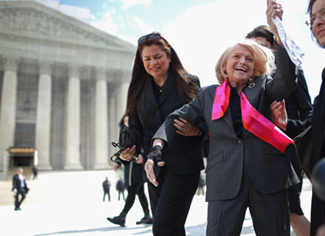
United States v. Windsor
What your Louisiana LGBT clients need to know

Slide 2
Overview of U.S. v. Windsor
Background: Edith Windsor legally married her partner, Thea Spyer, in Canada 2007. Both were residents of New York, which recognized same sex marriages performed in other countries and states.
Thea Spyer died in 2009 and left her estate to Edith Windsor. Ms. Windsor tried to claim the federal exemption from estate tax and was denied based upon the Defense of Marriage Act (“DOMA”), which defines marriage as between a man and a woman.
She was required to pay $363,053 in estate taxes.
Ms. Windsor brought suit on the basis that DOMA violated the Equal Protection Clause incorporated in the Fifth Amendment.

Slide 3
Outcome of U.S. v. Windsor
The Supreme Court of the United States held that Section 3 of DOMA was invalid because it violated equal protection under the Fifth Amendment.
The pertinent part of Section 3 of DOMA reads: “…the word ‘marriage’ means only a legal union between one man and one woman as husband and wife, and the word ‘spouse’ refers only to a person of the opposite sex who is husband or a wife.”

Slide 4
What Does U.S. v. Windsor mean for the LGBT Community?
The holding in Windsor means that federal benefits are now available for LGBT couples who have been married in a state or country that allows same-sex marriage.
Windsor did not invalidate Section 2 of DOMA which allows an individual state to refuse to recognize a lawful same-sex marriage performed in another state or country.

Slide 5
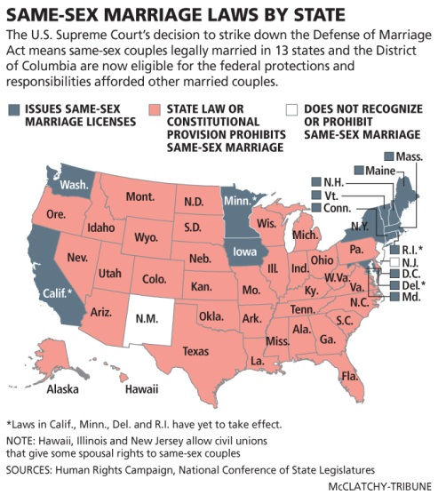
What States Allow Same-Sex Marriage?

Slide 6
Requirements for Louisiana LGBT couples to receive federal benefits
In order for federal benefits to be available to LGBT couples in Louisiana, they must get married in a state or country that allows same-sex marriage.
Not all federal benefits are available for LGBT married couples living in Louisiana. Some federal agencies determine eligibility for benefits based on the domicile of the couple. Other agencies determine eligibility based on the “place of celebration” of the marriage. I.e. if the couple married in New York state, but live in Louisiana, they are still entitled to certain benefits.

Slide 7
What Federal Benefits Are Available to Louisiana LGBT Couples?
Joint filing of federal income tax returns
Earned Income Tax Credit and Child Tax Credit for same sex couples with children
Tax on gain from sale of principal residence
Unlimited gift tax exemption
Unlimited estate tax exemption
Portability
Gift splitting
Immigration
No longer taxed on employer contributions to health care for same sex spouse
Considered spouse for ERISA plans

Slide 8
Federal Employees
Same sex spouses of federal employees are now eligible for a myriad of benefits
One of the biggest benefits is the Federal Employees Health Benefits Program
The Health Benefits Program will also be available to children and step-children of same sex married couples.
Federal pensions: if make an election for survivorship then will have deduction in monthly annuity
Family Medical Leave Act

Slide 9
Military Benefits
Same sex married couples, even those living in a state that doesn’t allow same sex marriage are entitled to spousal military benefits. Those benefits include:
Military retirement and survivor benefits
TRICARE medical plan
Military family leave
Command-sponsored visa
Dependent rate housing allowance
GI Bill

Slide 10
IRS Revenue Ruling 2013-17
The IRS issued a ruling on August 29, 2013, which states that all same sex couples married in a state or country which allows same sex marriage will be treated as married no matter where they reside.
The ruling does not apply to domestic partnerships

Slide 11
The Brave New World of Federal Tax Returns
Revenue Ruling 2013-17 means that all same sex married couples (as long as they were married in a state or country that allowed same sex marriage) will have to file a joint federal return, or elect “Married Filing Separately”.
Same sex couples can elect to file amended tax returns or gift tax returns for 2010-2012.
Same sex widows can elect to amend the estate tax return.

Slide 12
To Amend or Not to Amend?
The lawyer answer: “It depends.”
Do the spouses have disparate incomes? If so, may want to amend.
Was one spouse covered under the other spouse’s employer-sponsored healthcare plan? If so, may want to amend to recoup taxes paid by the employed spouse on the value of the healthcare coverage.
Were any gift tax returns filed? If so, will want to amend.
Will amending invite an audit?

Slide 13
Louisiana State Income Tax Returns: Lawsuit Fodder and the Stuff of Nightmares for CPAs
Louisiana’s revenue department has stated that it will not allow same sex married couples to file a joint or “married filing separately” state return
Louisiana’s constitution specifically prohibits same sex marriage
Louisiana law requires that a taxpayer file using the same status on both federal and state returns
Louisiana LGBT will have to file separate state returns as “single” or “head of household”.

Slide 14
Federal Benefits that Aren’t Available to Louisiana LGBT
Several federal agencies are currently using the place of domicile test for benefits.
  Social Security
  Medicare/Medicaid
  Family Medical Leave Act for non-federal employees

Slide 15
Disadvantages of Living in Louisiana for LGBT couples
Louisiana LGBT couples do not have the protection of Louisiana law in several important areas:
  Intestacy
  Torts
  Divorce
  Adoption

Slide 16
Louisiana’s National Guard
Same sex spouses of members of the National Guard are also able qualify for spousal benefits. However, Louisiana National Guard has stated that it will not process requests for benefits from same sex married couples.
Same sex married couples have to travel to one of the eight federal military installations in Louisiana.

Slide 17
Retirement Plans
ERISA plans : The Labor Department stated that any plans which are governed by ERISA (profit-sharing retirement accounts, 401ks, defined benefit plans, etc.) will recognize legally married same sex spouse regardless of place of domicile.
Non-ERISA plans: Do not have to recognize same sex spouses.

Slide 18
Retirement Plan Benefits to Consider
Spousal rollover
Required Minimum Distributions – where a spouse is named as the sole beneficiary and the spouse is more than 10 years younger than the participant you can use Joint and Last Survivor Table to lower the RMD
Post-Mortem Required Beginning Date for RMDs where the participant died before the RBD– the surviving spouse can elect to start taking RMDs on April 1st after the surviving spouse turns 70 ½
Hardship distributions
Spousal consents – need to check with clients who named someone other than spouse as beneficiary
Qualified Domestic Relations Order (QDRO)

Slide 19
Pending Louisiana Lawsuit
Robicheaux v. Caldwell
On July 16, 2013, Jon Robicheaux, an Orleans Parish resident, filed suit against the Louisiana Attorney General. The suit alleges that the Louisiana law refusing to recognize a lawfully performed same sex marriage violates the Full Faith and Credit Clause.
The suit is currently in federal court.

Slide 20

The Future of Same Sex Marriage Litigation
Litigation is on-going throughout the country and will continue.
There are many issues left unresolved and the likelihood is the Supreme Court will have to rule in the next few years on whether marriage is a constitutional right which cannot be denied based on sexual orientation.
This area will continue to evolve quickly as litigation over issues such as equal protection and Full Faith and Credit are decided at the state and federal level.

