Slide 1
Transition by Design:
Successful Succession of the Privately Held Business
New Orleans Estate Planning Council
May 15, 2017
Susan P. Rounds
Director, Wealth Planning
(310) 788-6152
(770) 912-6533
susan.rounds@db.com

Slide 2
Overview
01
A Changing Marketplace
02
Integrated Master Plan Design
03
Strategic Opportunities
04
Changing Paradigms

Slide 3
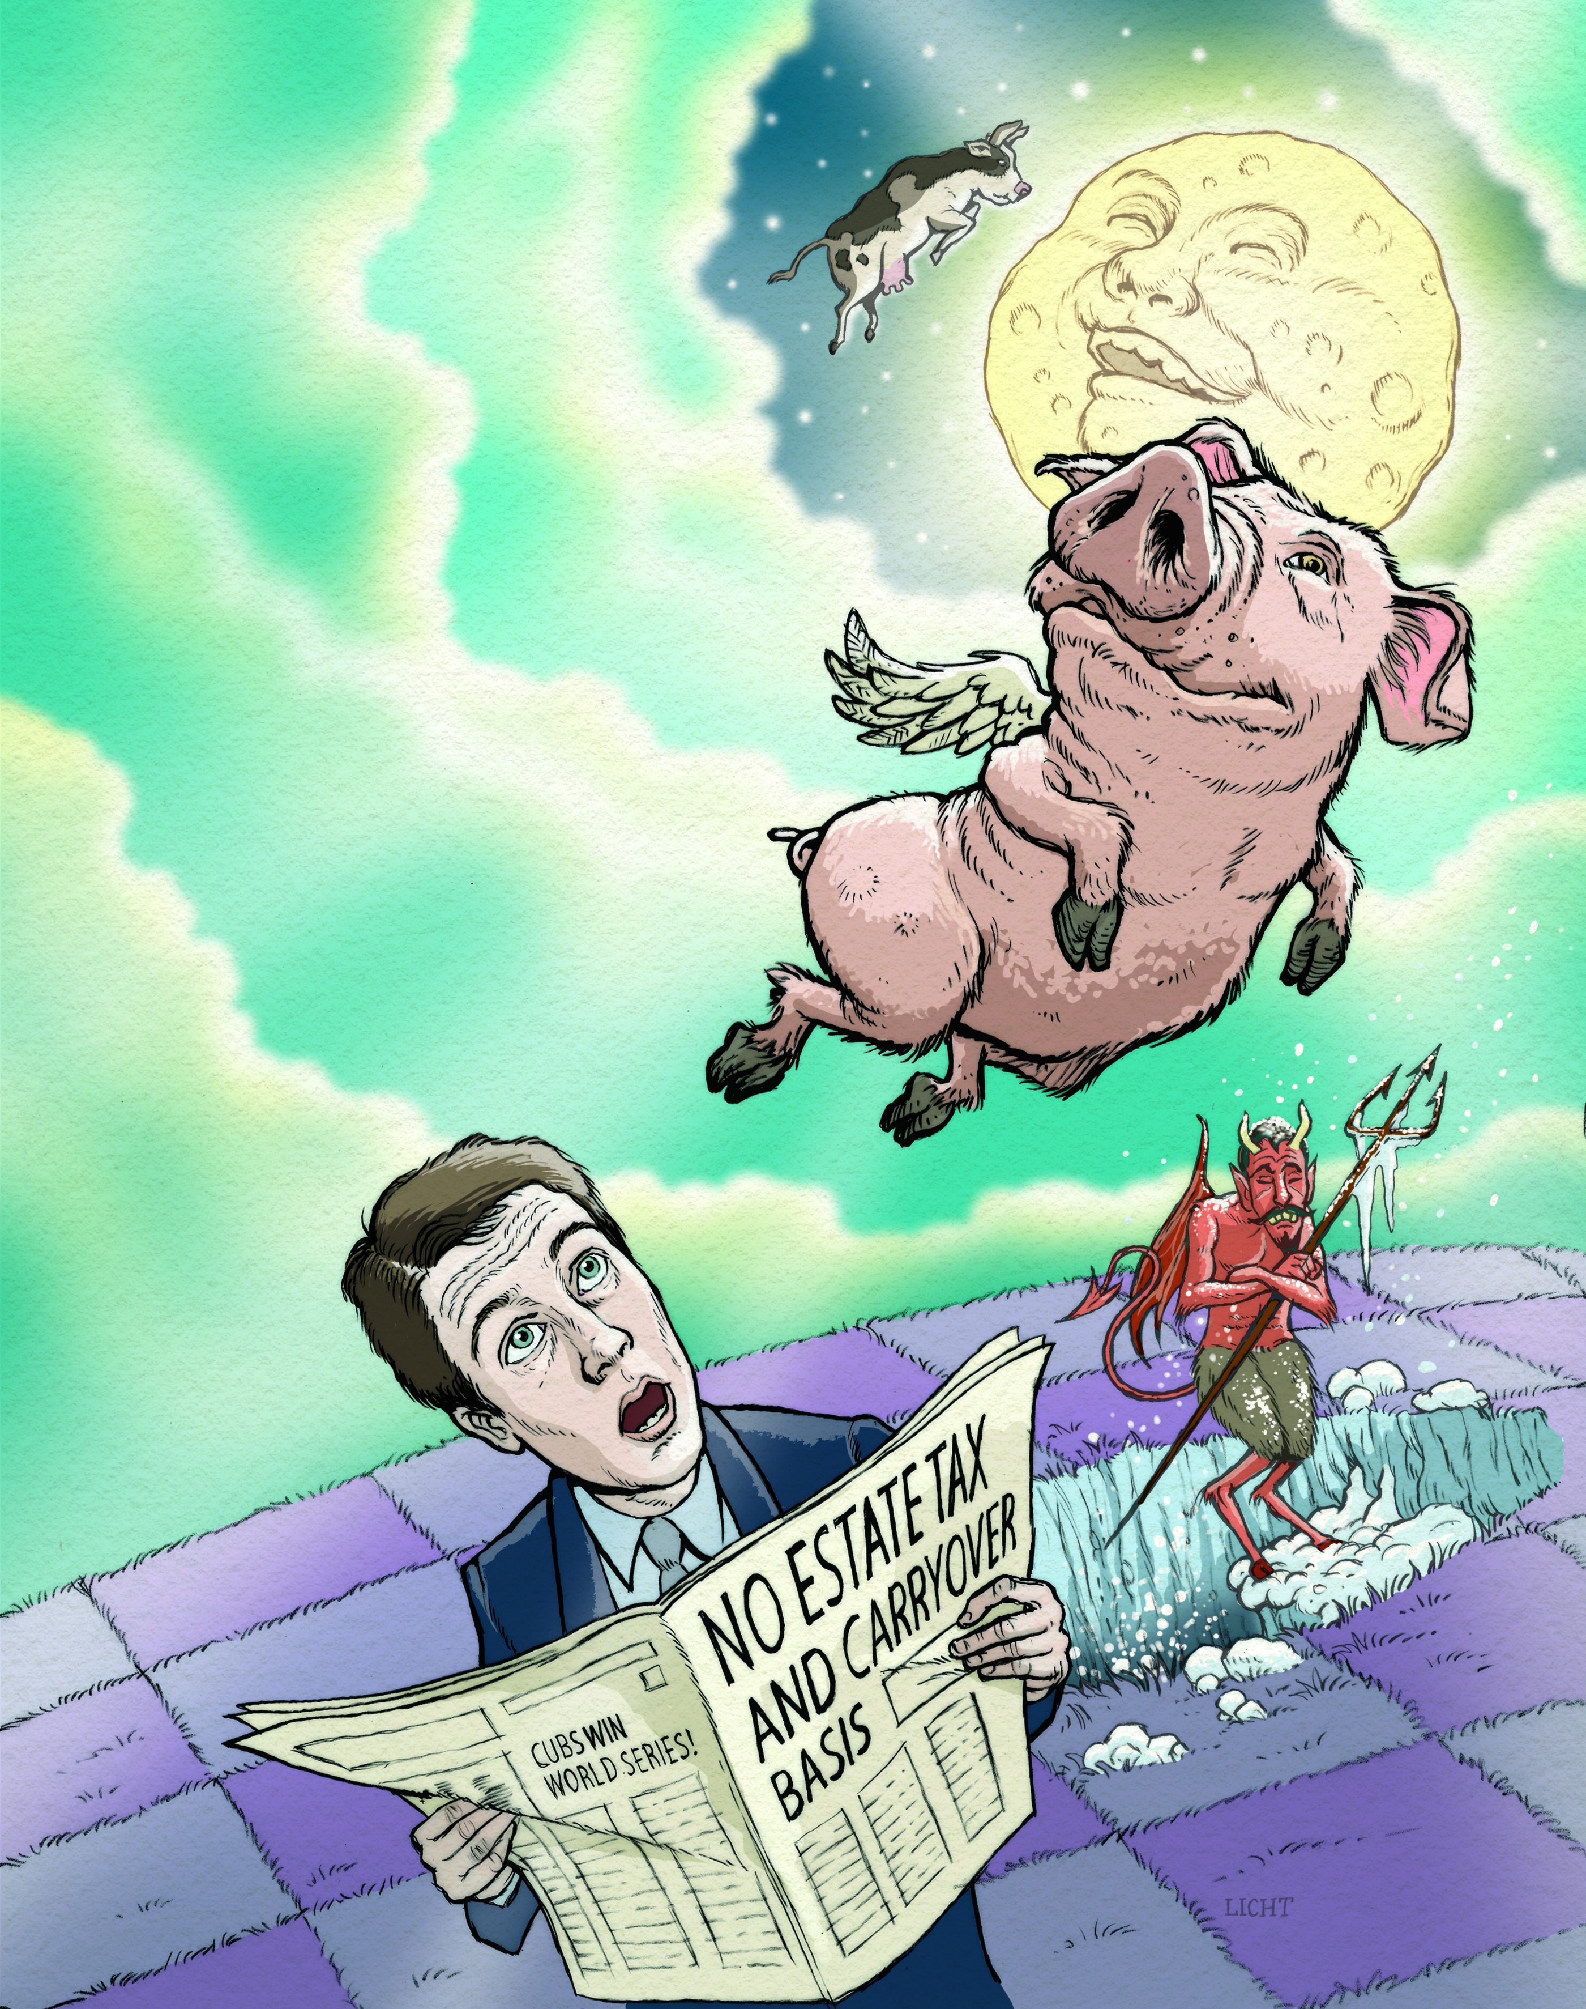
Some Legends Never Die

Slide 4
Business Succession Planning. . . and Yogi Berra
    “It's like déjà vu all over again!”
    New “what ifs" on a fairly consistent basis
    (NAEPC past president Jordon Rosen's article in NAEPC Journal of Estate and Tax Planning)
    September 8, 2016
    Better to wait and see?
    “When you come to a fork in the road – take it!”
    Plan ‒ No matter which turn is taken, the path is clear
    Static documents interpreted in light of dynamic new law
    FLEXIBILITY
    Disinherit spouse or other beneficiaries?
    “You’ve got to be very careful if you don't know where you’re going, because you might not get there!”
    Wealth in motion will be taxed!
    GIFT tax
    Capital gains tax – deemed sale / carry over
    State tax regimes
Source: USA Today – 50 greatest Yogi Berra quotes

Slide 5
A Changing Marketplace

Slide 6
Wealth Creation in the United States
Percentage of Millionaire Households That Own a Private Business by Net Worth Tier¹
(1) Federal Reserve 2013 Survey of Consumer Finances. Shows a 1.6% decrease overall in Holdings of Business Equity Across Tiers since 2005.

Slide 7
Winds of Change
Business Owner Age
Ownership Transition
65+
55-64
Under 55
Third Party
Family/Trust/Other
Management
Undecided
ESOP
Source: New York Times “Are Baby Boomers Ready to Retire?” February 11, 2011.
Source: VIP Forum 2010 Survey of Business Owners

Slide 8
Mission Critical
Issues of Greatest Importance and Difficulty for Family Businesses
Difficultly of Achieving
1
    Resolving conflicts among family members who are in the business
    Formulating a succession plan
    Developing a strategic plan
    Developing a retirement and estate plan
    Ensuring that the family’s core business values
    are maintained
    Financial growth plan
    Compensating family members in the business
    Bringing family members into the business
    Ensuring family members benefit from
    owning shares
    Bringing non-family executives into the business
    Transferring wealth and equity to family members not involved in the business
    Transferring wealth outside the business
Low Importance/
Difficult to Achieve
High Importance/
Difficult to Achieve
2
3
12
2
4
4
5
1
3
6
11
6
7
9
10
5
8
8
9
7
Low Importance/
Easy to Achieve
High Importance/
Easy to Achieve
10
11
Importance
12
Source: Grant Thornton, Results of Family Business Survey

Slide 9
Challenges Facing Family Businesses
    85% of the crises faced by the family business is focused around the issues of succession.¹
    According to the Small Business Association:²
    90% of America’s businesses are family owned
    30% make it to 2nd generation
    12% survive to 3rd
    3% reach the 4th
    Primary reason is failure to properly structure a succession plan³
    90% agree on importance of exit planning
    33% have a business succession plan
    Only 29% feel their team of advisors is qualified to help
(1) Keeping it in the Family: Business Succession Planning; Charles D. Fox IV; A.L.I.-A.B.A. (2011)
(2) Challenges in Managing a Family Owned Business; Small Business Administration (SBA.gov).
(3) VIP Forum 2012 Survey of Small Business Owners

Slide 10
Integrated Master Plan Design

Slide 11






Transition by default can be a real juggling act. . .
Competitive
Strategy
3rd Party
Sale MBO
or ESOP
Liquidity &
Income
Needs
Financing
Strategy
Keep in
Family
Family
Legacy
Management
Succession
Income
Tax
Estate
Tax
Asset
Protection
C, S or
LLC
Fair vs.
Equal
Incentive
Planning

Slide 12

. . .with serious consequences
3rd Party
Sale MBO
or ESOP
Family
Legacy
Asset
Protection
Income
Tax
Financing
Strategy
Competitive
Strategy
Management
Succession
Fair vs.
Equal
Estate
Tax
Liquidity &
Income
Needs
C, S or
LLC
Keep in
Family
Incentive
Planning

Slide 13


The Drivers – Business and Family Dynamics
Wealth
Creation
Wealth Preservation
Strategic Vision
Strategic Vision
Tax, Legal, Finance
Tax, Legal, Finance
People and Culture
People and Culture
Reward
Reward

Slide 14
Strategic Assessment
Business – Wealth Creation
Family – Wealth Preservation
    Business Plan
    Competitive Analysis
    Management Succession
    SWOT and Concentrations
    Legacy
    Wealth Transfer Philosophy
    Personal Financial Goals
    Family Business Council/Board of Advisors
Strategic Vision
Strategic Vision
    Choice of Entity – C, S, LLC
    Asset Protection and Core Assets
    Dividend/Profit Payout Policy
    Financial Statements
    Financial Stability
    Diversification
    Asset Protection
    Estate Tax
Tax, Legal, Finance
Tax, Legal, Finance
    Demographics
    Performance, Potential, Readiness
    Corporate Culture
    Rules of Entry
    Family Participation Policy
    Compensation
People and Culture
People and Culture
    Attract and Retain Top Talent
    Targeted Incentive
    Exit
    Strategic Communication
    Equity/Income
    Fair vs. Equal
    Business and Family Alignment
    Strategic Communication
Rewards
Rewards

Slide 15
Final Phase: Resolve Conflicting Objectives
    The owner of a family business envisions naming his son CEO.
    The CFO―a critical employee and NOT a family member―neither likes nor respects the son.
    In fact, the CFO, and others, will likely quit if the son is named CEO.
Business
Family
Strategic Vision
Strategic Vision
Tax, Legal, Finance
Conflict?
Tax, Legal, Finance
People and Culture
People and Culture
Reward
Reward

Slide 16
Strategic Opportunities

Slide 17
Know Your Numbers
Prevailing Factors | Amounts/Rates
Valuation Options | Strategic-Financial-Estate
Long-Term Capital Gain Rate | 20%
Qualified Dividend Rate | 20%
Top Income Tax Rate | 39.6%
Annual Gift Exclusion | $14,000 (“Use it or lose it”)
Lifetime/Death/GST Exemption | $5,450,000/$10,900,000 (portable)
Top Transfer Tax Burden | 40%
Additional Tax Burden | $66,000/month (per $20 million @7.2%)
Applicable Federal Rate (AFR) | Low by historical standards
February 2017 Rates | Short – 1.04%; Mid – 2.10%; Long – 2.81%
Medicare Surcharge | 3.8%

Slide 18




Evolution of a Business. . . .or De-evolution?
Chaos
Alignment
Start Up
Red Tape

Slide 19
Strategic Opportunities: All In The Family
    Create Financial Stability
    Take some chips off the table
    Tax-free dividends
    Diversify
    Prepare for Management Succession
    Identify and groom an heir apparent
    Design incentive to attract/retain/reward top talent
    Establish Private Business Governance Model
    Family Business Council
    Board of Advisors
    Dividend policy

Slide 20
Strategic Opportunities: All In The Family
    Classic Freeze
    Valuation discounts
    Low AFR cycle
    The “No Plan” plan can result in additional $66,000/month in estate taxes¹!
    Consolidate Ownership
    Buy out non-optimal shareholders
    3.8% Medicare surcharge
    Low capital gains
(1) For illustrative purposes only.

Slide 21
Strategic Opportunities: Sale to Third Party
    Wear Hat of Buyer
    Curb appeal
    Assess drivers
    Talented and likeable managers
    Audited financials
    State of the Market
    Frothy?
    “Private equity firms now have more than $1 trillion of available capital. Expect more deals at higher prices.” – Fortune.com

Slide 22
Strategic Opportunities: Sale to Third Party
    What’s It Worth?
    Strategic vs. financial buyers
    EBITDA vs. adjusted EBIDTA
    Multiplier
    Industry specific
    Growth prospects
    Firm size
    Established financial history
    Earnings stability/volatility
    Top talent in place
    Owner participation
    Concentrations
    Unique vs generic product/service
    Strategic Positioning
    It’s not what you get – it’s what you keep
    Long-term capital gain rate still low (20%).
    Core Assets – Real Estate ‒ Cash

Slide 23
Strategic Opportunities: The Rest of the Story
    Other Options
    Internal management buy-out
    ESOP
    IPO
    Polishing the Apple
    Knowledge is power!
    Manage as a dual track process
    Plan A as chosen with
    Back-up Plan B
    Analyze value, cash flow, liquidity and risk

Slide 24
Changing Paradigms

Slide 25
Valuation Planning
    The Old Paradigm
    “I know what my business is worth based on the offers I get.”
    The New Paradigm
    “Valuation is an art . . . and a science.”
    Strategic $30 million
    Financial $25 million
    Estate $18 million
    Purpose driven
    Preserve confidentiality

Slide 26
Family Business vs. Family Wealth
    The Old Paradigm
    “My grandparents started this business and I am keeping it for my kids and grandkids.”
    The New Paradigm
    “The business world is more complicated than it used to be. My family wants to do something else.”
    Control of family wealth is more critical than control of family business
    Opportunity cost. Would you buy your business at the same price?

Slide 27
Static Documents vs. Dynamic Objectives
    The Old Paradigm
    “I own my business 100%, so no need for employment agreement, incentive plan or shareholder’s agreement.”
    The New Paradigm
    “I have to strategically position the business and wealth. Protect the business, my family and employees.”
    Keep
    Death, disability and retirement
    Ownership and management continuity
    Establish rules of entry and family business governance
    Market rate vs. birthright
    Transition to third party
    Position/protect A-team players
    Conflicting documents

Slide 28
Strategic Positioning – Next Steps
    Put Team together
    AEP® is collaboration designation!
    Understand your options
    Learn where business and family goals are at cross-purpose—and align
    Establish legacy for future generations
    Plan and fund away the estate tax obligation

Slide 29



Freedom of Choice
More dollars to
Your Businesses
Your Family
Your Community

Slide 30
Important information
As a New York State-chartered bank, Deutsche Bank Trust Company Americas is required by law, under penalty of sanctions, to ensure that securities held by it as a custodian are segregated on its books and records from the Bank’s own assets. In addition, internal control procedures are in place to prevent clients’ securities from being commingled with the Bank’s own assets. As an additional safeguard, the information systems that record and account for clients’ custodied securities are independent from the systems within the Bank which track and control the Bank’s proprietary assets. These segregation requirements required by law are intended to protect securities of custody clients against claims of creditors of a bank. In the event that there are cash deposits in a client’s custody account, i.e. a money market deposit account, and such deposits are held within the Bank, then those deposits would be entitled to deposit insurance provided by the FDIC, subject to the limitations provided by federal law.
This document is for information/discussion purposes only and does not constitute an offer, recommendation or solicitation to conclude a transaction and should not be treated as giving investment advice. The document is addressed to qualified investors only. The information contained herein is confidential and may not be reproduced or used or distributed in whole or in part without the prior written consent.
The past performance of securities or other instruments does not necessarily indicate or predict future performance. Since the value of investments and income arising therefrom can fall as well as rise, the investor may get back less than was invested and no assurance can be given that any portfolio or investment described herein would yield favorable investment results. Any products mentioned herein are not FDIC insured and are not obligations of nor guaranteed by Deutsche Bank AG or its affiliates unless otherwise specified.
Deutsche Bank AG, including its subsidiaries and affiliates, does not provide legal, tax or accounting advice. This communication was prepared solely in connection with the promotion or marketing, to the extent permitted by applicable law, of the transaction or matter addressed herein, and was not intended or written to be used, and cannot be relied upon, by any taxpayer for the purposes of avoiding any U.S. federal tax penalties. The recipient of this communication should seek advice from an independent tax advisor regarding any tax matters addressed herein based on its particular circumstances.
This document may not be reproduced or circulated without our written authority. The manner of circulation and distribution of this document may be restricted by law or regulation in certain countries, including the United States. Persons into whose possession this document may come are required to inform themselves of, and to observe, such restrictions.
"Deutsche Bank" means Deutsche Bank AG and its affiliated companies. Deutsche Bank Wealth Management represents the wealth management activities conducted by Deutsche Bank AG or its subsidiaries. Brokerage services are offered through Deutsche Bank Securities Inc., a broker-dealer and registered investment adviser, which conducts securities activities in the United States. Deutsche Bank Securities Inc. is a member of FINRA, NYSE and SIPC. Discretionary portfolio management, banking and lending services are offered through Deutsche Bank Trust Company Americas, member FDIC, and other members of the Deutsche Bank Group. Trust and estate and wealth planning services are provided through Deutsche Bank Trust Company, N.A., Deutsche Bank Trust Company Delaware and Deutsche Bank National Trust Company.
© 2017 Deutsche Bank AG. All rights reserved.

